Slide 1

STEREO Analysis
Jack LaSota

Slide 2
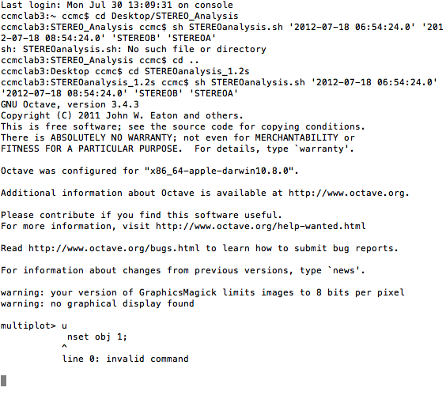
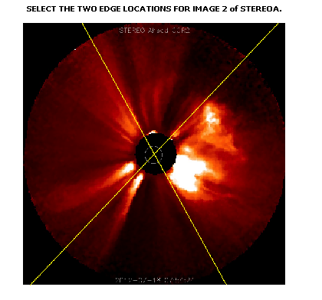
What it replaced

Slide 3
Image Choice
Old tool required that you knew the timestamps of the images you wanted to use.
New tool lets you browse through available images.

Slide 4
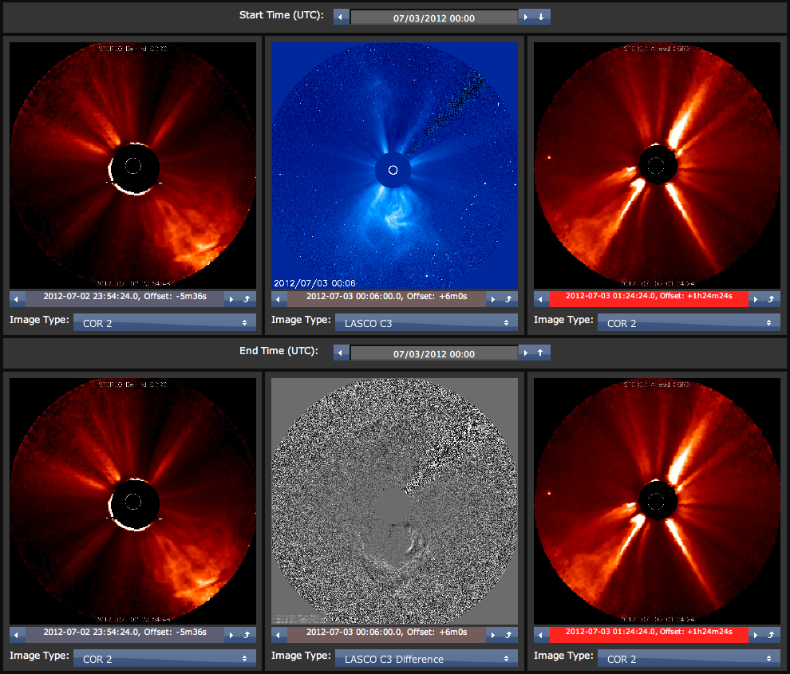

Slide 5
Measurement
Old tool made you click once to pick each point on the images. All points were chosen in a sequence and you could not change anything without restarting the program.
New tool lets you drag handles to pick the points. As you do this, it recalculates continuously.

Slide 6
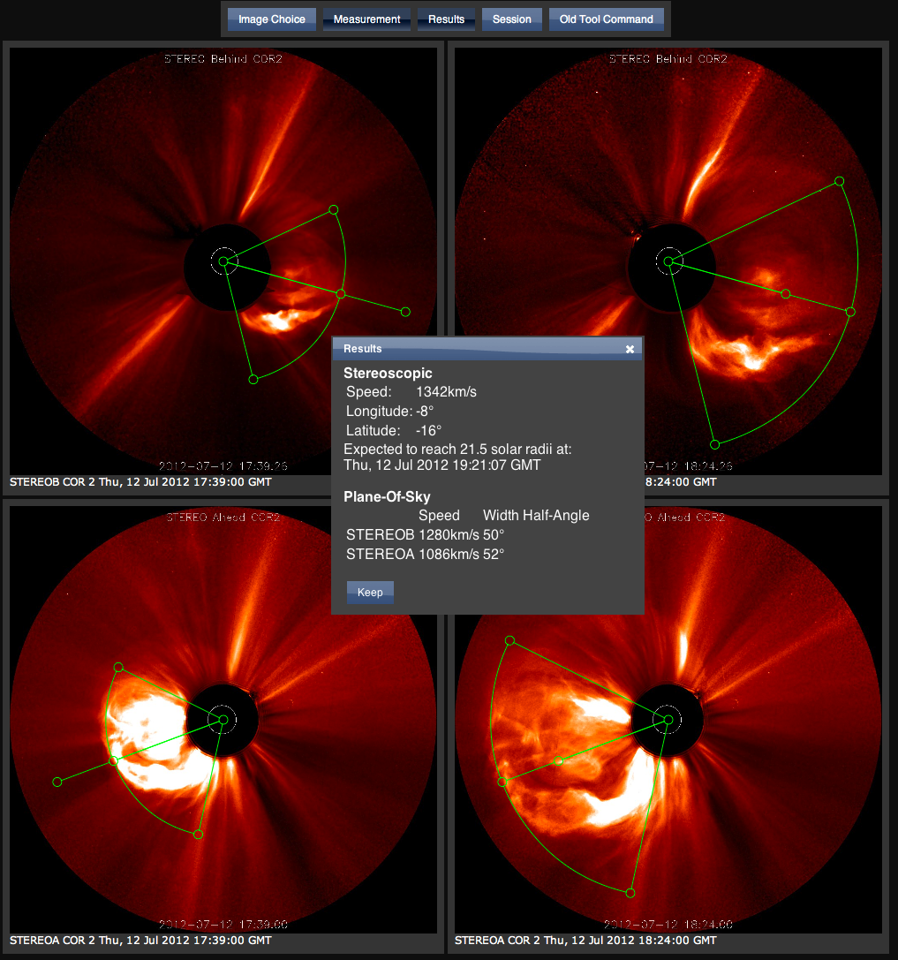

Slide 7
Sessions
Users of the old tool would paste results from many runs of the program from the command line to a text file, and eyeball the average of many measurements.
New tool collects measurements in a table, and shows the mean and standard deviation. Allows user to open and edit saved measurements, and generate a URL that can restore the whole session.

Slide 8
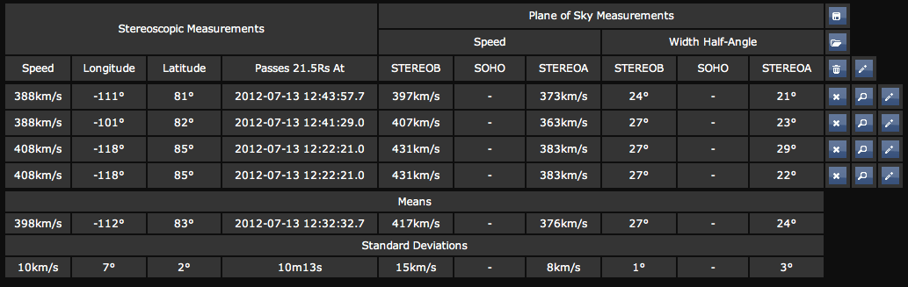

Slide 9
Thanks to
Antti Pulkkinen
David Berrios
Leila Mays
Richard Mullinix
Marlo Maddox
Anna Chulaki

